Slide 1
While Loops vs For Loops

Slide 2
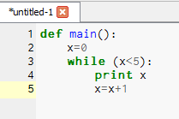
A while loop keeps happening as long as the condition is true. The program keeps looping back to check until it gets past this part.

Slide 3


Slide 4
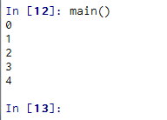

Slide 5
Write a program to say “Go Tigers”, while x<10.

Slide 6
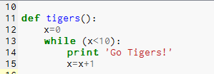

Slide 7
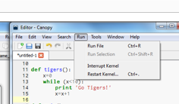
If you accidentally put it in an infinite loop of spelling “Go Tigers!”
Click on Run and Restart Kernel
1. If you forget the counter x=x+1
2. If you write your counter incorrectly, i.e., x=+1 (correct is x+=1).

Slide 8
A while loop kept happening as long as the condition was true.
A For loop iterates over a list of items or a range.

Slide 9


Slide 11
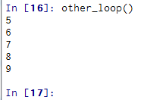

Slide 12


Slide 14


Slide 15
Write a for loop to print out the names
of the people in your row.

Slide 16
Review of the random commands we used last week.

Slide 19

Write statements which will pick a person randomly in your row.

Slide 20


Slide 21
Write a program picking a number between 1 and 100 randomly.

Slide 22

Picks a floating point number randomly.

Slide 23
Just like we imported “random” we can also import additional pre-built functions, like matplotlib.pyplot.
This is a graphing function that plots histograms, bar charts, line charts, etc.

Slide 24
import matplotlib.pyplot as plt.
or,
import matplotlib.pyplot as p.
Later, to plot and view the charts:
plt.hist(data)
plt.show()
Or,
p.hist(data)
p.show()

Slide 25
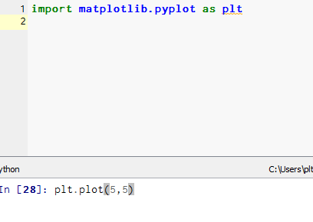

Slide 26
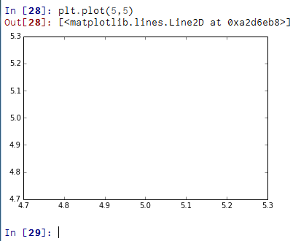

Slide 27


Slide 28
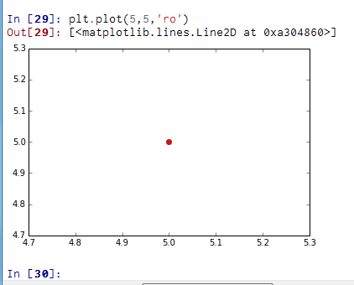

Slide 30
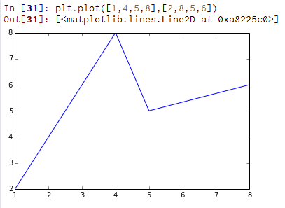

Slide 32
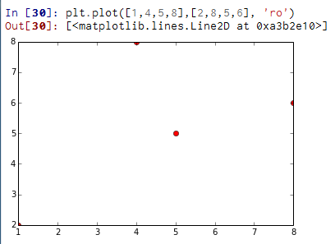

Slide 33
If you are a star (and want to complete the “Hacker Edition” of the course), work through:
Activity 1.3.7 For Loops
Activity 1.3.8 While Loops

